Slide 1


CoderDojo Athenry
Athenry
Code and notes by Martha Fahy, 2017

Slide 2

CoderDojo Athenry
"Above all, be cool"
Every week:
Sign in at the door
If you are new:
Fill in Registration Form
Ask a Mentor how to get started
Make sure you are on the Athenry Parents/Kids Google Group: email coderdojoathenry@gmail.com
Wireless Password: coderdojowireless

Slide 3
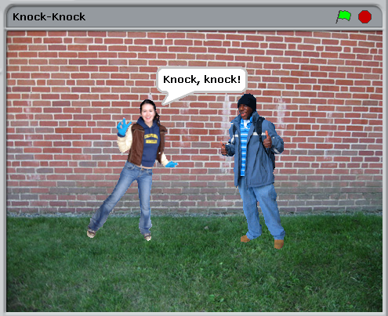
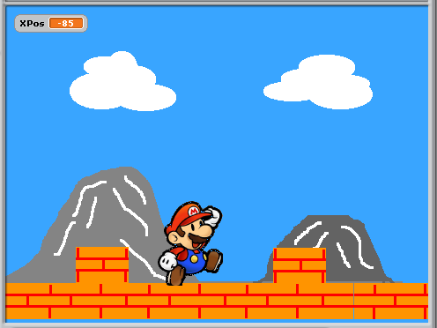
Today's Challenge: More Animation Storytelling and Scrolling!

Slide 4
Today's Big Ideas
Speech Bubbles & Sound
Loops & Timing
Sprites
Imagination!

Slide 5
Telling A Story
Your sprites can be actors in your own story or joke!

Slide 6
How To Do It
Pick some sprites
Decide what they should do & say
Use times and waits so they sync up

Slide 7
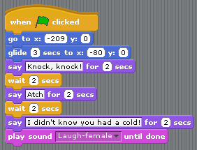

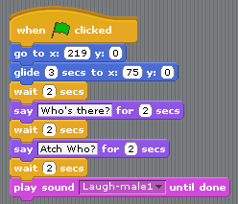

How To Do It: The Code
Make sure these times match
And these!

Slide 8
You Can Do Lots More!
Think of new stories or jokes
Record voices on the Sound tab
Animate with different costumes
Use Broadcasts for more syncing

Slide 9
Another Challenge:
Scrolling Backgrounds
Stage can't move: need to use sprites for moving background

Slide 10
The Scratch Stage
480
240,180
0,0
+
360
y
-240,-180
x
Sprites can't be bigger than stage: max length is 480 also

Slide 11


To make it look like Mario is moving Right …
Don't move Mario,
Move the ground Left
x
Sprites can't be bigger than stage: max length of each one is 480,
so we need at least two of them.
Add more to make ground longer.

Slide 12


How to do it, Part 1 …
Make a variable XPos: x-position of the first ground sprite.
The second ground sprite will be at x-position XPos + 480.

Slide 13
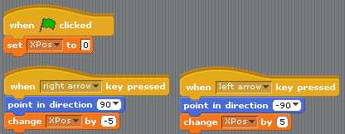
How to do it, Part 2 …
Reducing XPos makes the ground move to the left, to give impression that Mario is moving right.

Slide 14
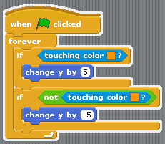
Make Mario stand on the ground …
y
If below ground (touching colour), move Mario up a bit.
If above ground (not touching colour) move Mario down a bit.

Slide 15

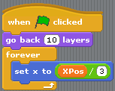

Advanced Idea: Parallax Effect
Mountains appear to move more slowly, so change their XPos by a smaller amount.
Also need to consider layers: the ordering of the sprites.

Slide 16
At the End …
Upload your project to the Scratch Website
user: cdathenry1617 password: athenry1617
Access it
from home
Improve it
Show your
friends!

