Slide 1

CoderDojo Athenry
"Above all, be cool"
Notes by Michael Madden, 2013

Slide 2
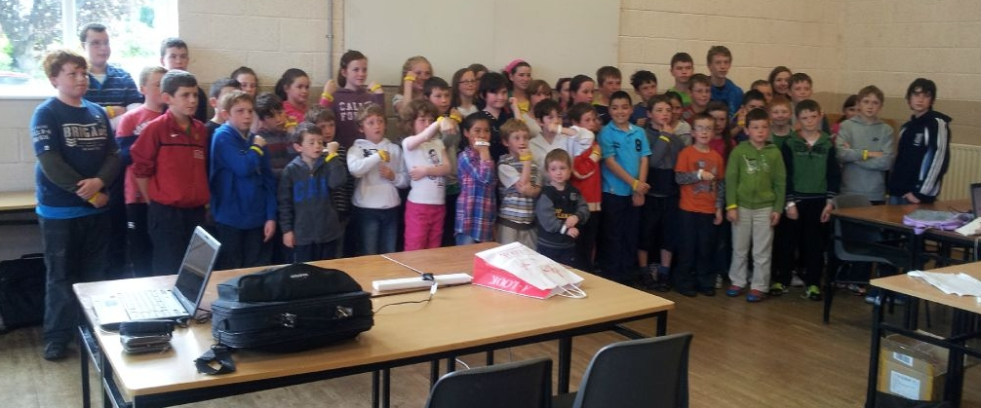
Belts & Certs!
Notes:
30 June 2012. 55 belts: 45 yellow + 10 white.

Slide 3
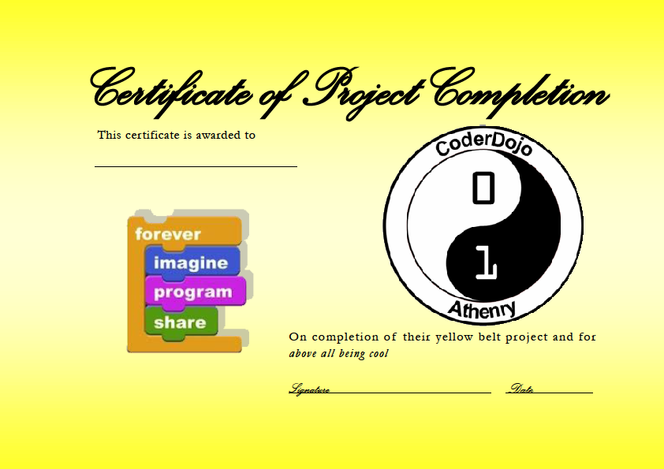
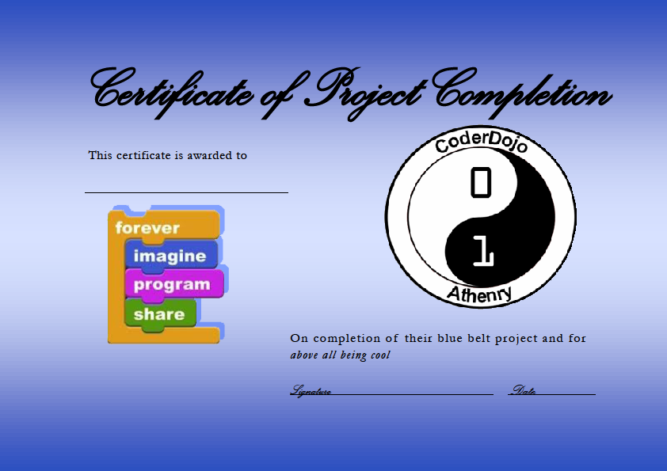
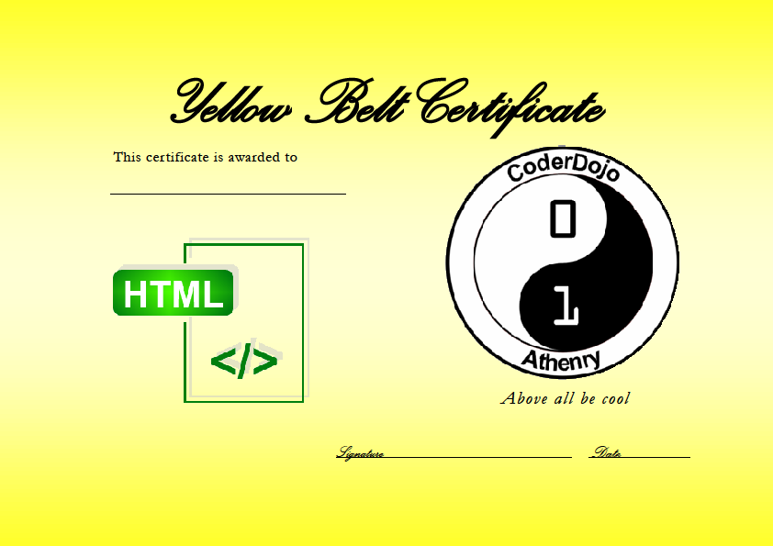

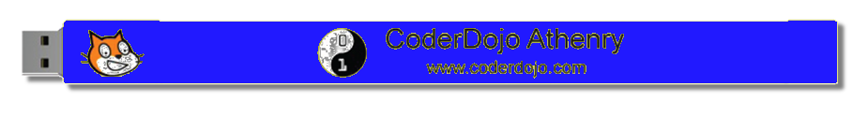
Belts & Certs!

Slide 4

Earning a White Belt
White: Commitment & Basic Skill
Attend at least 5 sessions
+ Know how to get started with a language
Sign in each week!

Slide 5
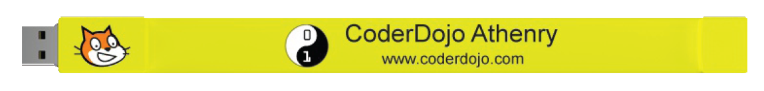
Earning a Yellow Belt
Yellow Scratch Belt: Competent Scratch Coder
Qualify for a White Belt
Write and explain a Scratch Program with:
Forever/Repeat If blocks
Variables Animation/Sound
Sprite controlled by mouse or keyboard
Must be all your own work!
Separate yellow/blue belts for each language

Slide 6
Earning a Blue Belt
Blue Belt: Advanced Coder
Earn a Yellow Belt
+ Complex Project
+ Teamwork
+ Design
+ Social Good

Slide 7
Cert: Yellow or Blue
Have previously earned a yellow/ blue belt
Show us your project that uses ideas from multiple weeks

